Slide 1
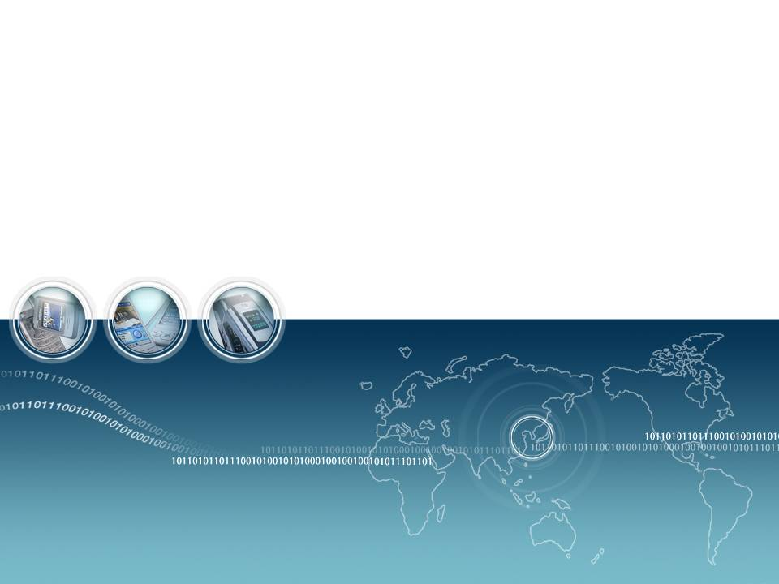
Lecture 6: Visible Light Communication

Slide 2

Outline
Part 1
VLC introduction
LED introduction
VLC potential application
Part 2
VLC components
Technical challenges

Slide 3
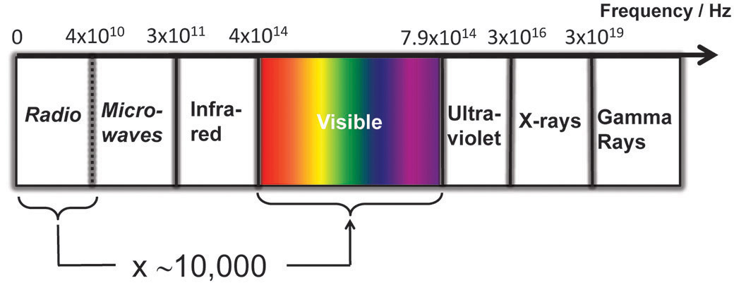
VLC introduction
VLC (Visible Light Communication)
: New communication technology using “Visible Light”.
Visible Light
: Wavelength between ~400nm (750THz，purple) and ~700nm (428THz，red)

Slide 4
VLC introduction （2）
General Characteristic
Visibility : Aesthetically pleasing (美观)
Security : What You See Is What You Send.
Health : Harmless for human body and electronic devices
Unregulated : no room to use more radio frequency（无管制）
Using in the restricted area : aircraft, spaceship, hospital
Eye safety

Slide 5
VLC history
~
800 B.C.
400 B.C.
280 B.C.
1800s
1880
1900s
Current
Sunlight
Heliograph
（日光反射器）
Photophone
By Bell
Fire
Beacon
Fire
（烽火台）
Pharos
Lighthouse
（法罗斯灯塔）
Burning Kite
In Battle
Lamp
Ship-to-ship
Comm.
Traffic Light
/Signboard Light
VLC
LED

Slide 6

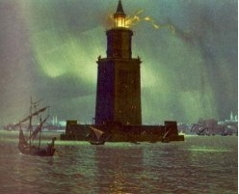
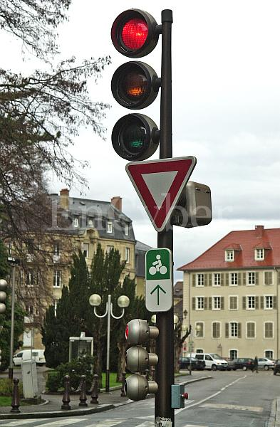
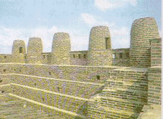
VLC history – Low speed
Information delivery through reflection by mirror (Heliograph，日光反射器)
The use of fire or lamp
Beacon fire(烽火台), Pharos lighthouse(法罗斯灯塔), ship-to-ship comm. by Morse code (1800s)
Traffic light : signal discrimination by color (Walk/Stop)
Morse
code
Notes:
斯巴达300勇士 法罗斯灯塔：在法罗斯岛上矗立着被称为古代世界七大奇观之一的灯，280 B.C. 摩斯密码编码简单清晰，二义性小，编码主要是由两个字符表示："."、"-"，一长一短
1912年，著名的泰坦尼克号游轮首航遇险时，发送的是CQD（英国马可尼无线电公司决定用CQD作为船舶遇难信号），但因D（—··）易于其他字母混淆，周围船只并未意识到是求救信号，没有快速救援，在快沉没时才使用的新求救信号SOS（···———···）发报。泰坦尼克号沉没后，SOS才被广泛接受和使用。

Slide 7
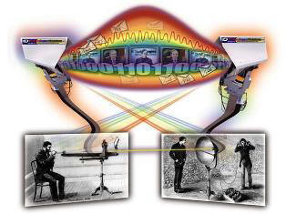
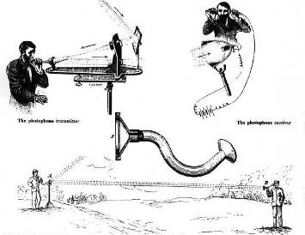
VLC history - Photophone
Bell’s Photophone (光电话，1880)
Optical source : sunlight
Externally modulation by vibrating mirror (振动镜外调制)
Receiver : parabolic mirror with crystalline selenium cells (带有结晶硒网格的抛物面镜)
700 ft (213m) sound transmission
http://www.freespaceoptic.com/
Excerpted from: The New Idea Self-Instructor edited by Ferdinand Ellsworth Cary, A. M. (Monarch Book Company, Chicago & Philadelphia, 1904)
Notes:
1880年，Alexander Graham Bell和他的助手Sumner Tainter公布了光通信技术的巨大进步，他们称之为“光电话”。没有激光或现代检测器的帮助，光电话可以在数百米的光束上传输人类声音。光电话是世界上第一个光电系统，贝尔和泰纳的实验至少比无线电进行无线语音通信早了19年。

Slide 8
Frequency band for VLC
Low Frequency
(Long wavelength)
Coverage
Mobility
High Frequency
(Short wavelength)
Bandwidth
Security
300MHz
10GHz
300GHz
3THz
428THz
750THz
300PHz
RF
IR
visible
UV
1m
3cm
1mm
100μm
700nm
400nm
1nm
IG-THz
IrDA
802.15.3c
(个域网)
IG-VLC
802.11(局域网)
802.16（城域网）
IG-THz : contribution 15-07-0623-01, AT&T Labs discussed the Terahertz spectrum band
which covers 300 GHz to 10 THz.
This mmWave WPAN will operate in the new and clear band including 57-64 GHz unlicensed band
The millimeter-wave WPAN will allow high coexistence (close physical spacing)
with all other microwave systems in the 802.15 family of WPANs
Notes:
Terahertz Interest Group (IGthz) ：2012年日本东京工业大学预测利用太赫兹通信技术进行无线数据传输的速度，理论上可以高达每秒100千兆位。
IrDA是红外数据组织（Infrared Data Association），到目前为止，全球采用IrDA技术的设备超过了5000万部。初始的IrDA1.0标准制订了一个串行，半双工的同步系统，传输速率为2400bps到115200bps，传输范围1m，最近IrDA扩展了其物理层规格使数据传输率提升到4Mbps。

Slide 9
VLC Characteristic
HDR UWB
480M
UWB
100M
802.11a
50M
Data rate (bps)
UFIR
802.11b
16M
VLC
FIR
4M
Bluetooth
VIR
115K
IR
ZigBee
2400
1
2
3
6
11
20
50
Distance (m)
Notes:
FIR为IrDA物理层标准陈废的名词，虽然如此这个名词却也常用在表示4百万位元/秒速率。 IR，VIR，FIR，UFIR都是红外技术 。 ZigBee，也称紫蜂，是一种低速短距离传输的无线网上协议，ZigBee工作在20～250kbps的速率。 IEEE 802.11，1997年，原始标准（2Mbit/s，播在2.4GHz）。 IEEE 802.11a，1999年，物理层补充（54Mbit/s，播在5GHz）。 IEEE 802.11b，1999年，物理层补充（11Mbit/s，播在2.4GHz）。

Slide 10




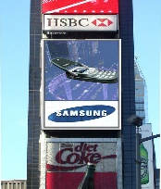
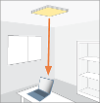
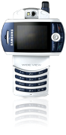

VLC Characteristic
(mW/Mbps)
Non-LOS
Interference
1Mb/s, 1m
100
Power consumption
Speed
50 Mb/s, 50m
500 Mb/s, 3m
10
4 Mb/s, 1m
LOS
Security
1
10
100
1000
Distance × Speed (m × Mb/s)
Directivity + Simplicity
Optical connectivity saves power

Slide 11
VLC vs. RF Characteristic
Property |  | VLC | RF
Bandwidth |  | Unlimited, 400nm~700nm | Regulatory, BW Limited
EMI(对外干扰) |  | No | High
Line of Sight |  | Yes | No
Standard |  | IG-VLC | Yes
Hazard(危害) |  | No | Yes (H₂O reaction to 2.4GHz)
Mobile To Mobile | Visibility (Security) | Yes | No
 | Power Consumption | Relative low | Medium
 | Distance | Short | Medium
 | Power Budget | Tight | Medium
Infra to Mobile | Security | Yes | No
 | Infra | LED Illumination(照明) | Access Point
 | Mobility | Limited | Yes
 | Coverage (Distance) | Short (~10m) | Wide (Short ~ Long Range)
Notes:
EMI是指电子产品工作会对周边的其他电子产品造成干扰

Slide 12
VLC motivation
Communication community trend
Ubiquitous (Connect each other everywhere, every time)
Security
LED trend
LED technology (efficiency, brightness)
LED Cost
Environmental trend
Health
Energy saving
Intrinsic characteristic of VLC
Visibility
No interference / No regulation

Slide 13
Outline
Part 1
VLC introduction
LED introduction
VLC potential application
Part 2
VLC components
Technical challenges

Slide 14
LED technical evolution
Performance and Price comparison
2003
100
LED
2005
10
LED
Cost / Brightness ratio
2010
LED
1
Halogen
Lamp (石英灯 )
Fluorescent Lamp
(荧光灯)
2015
Incandescent
Lamp (白炽灯)
HID
(High-Intensity Discharge,
高强度放电灯)
LED
0
50
100
150
Brightness / Power ratio
Source: Credit Suisse, 2006.11.2
Notes:
白炽(chi)灯
卤素灯(石英灯)：白热灯的一种，卤素灯是白炽灯的改进，它保持了白炽灯所具有的优点：简单、成本低廉、亮度容易调整和控制、显色性好（Ra=100）。同时，卤素灯克服了白炽灯的许多缺点：如使用寿命短、发光效率低（一般只有6%～10%可转化为光能，而其余部分都以热能的形式散失）。

Slide 15
LED driver
Air Pollutions(空气污染)
UNFCCC (United Nations Framework Convention on Climate Change,联合国气候变化框架公约), Kyoto Protocol(京都议定书) to the UNFCCC
(Dec. 1997)Decreasing CO2(10 k ton/year, 2002 at Korea)
Waste Materials & Environmental Hazards
RoHS (Restriction of the use of Certain Hazardous Substance,限制使用某些有害物质): 1, July 2006.
Pb(铅), Hg(汞), Cd(镉), Cr6+, Polybrominated biphenyls(PBB,多溴联苯),
Polybrominated diphenyl eters(PBDE,多溴二苯醚)
WEEE (Electrical and Electronic Equipment )
Producer Responsibility
Energy saving effect
Electricity at Korea
278 TWh(万亿瓦时),2002, 7.2 % of USA
20% for Lighting:55.6 TWh
50% saving by LED:27.8TWh
Energy Saving Effect:
3 Nuclear Stations (1GW/day)
2 B$/year
Source: KOPTI (The Korea Photonics Technology Institute)

Slide 16
LED Market Forecast
LED market comparison with NAND, DRAM
LED
※CAGR :15%
NAND, DRAM
29
billion $
29.2
billion $
LED
DRAM
11
billion $
12.4
billion $
6.3
billion $
LED
NAND
LED
2002
2010
2017
2006
2006
Source: Deutsche Bank, 2007. 2

Slide 17


LED application
General Lighting
Back Lighting
Economical
efficiency
General Lighting
Task Lighting(工作照明)
Signal Lamp
Mobile Phone
Home applications
digital device
TFT LCD TV
LED
Applications
Display
Communication
Exterior, interior
display
Sign & Architecture
display
LED screen
VLC
Mobile to Mobile
Infra to Mobile
Notes:
LEDs have been widely applied to back lighting, flashlamp, screen display, the signal direction and transportation means.
LED广泛应用于背光、闪光灯、屏幕显示、信号指示及交通工具等各个方面。

Slide 18
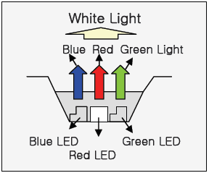
LED modulation characteristics
B + Phosphor(磷光体) LED
R+G+B LED
RCLED
(共振腔LED)
~40 Mb/s
~100 Mb/s
~500 Mb/s
Notes:
DBR（布拉格反射镜）

Slide 19
Outline
Part 1
VLC introduction
LED introduction
VLC potential application
Part 2
VLC components
Technical challenges

Slide 20

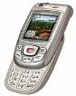
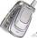
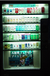
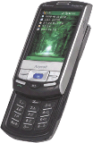

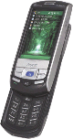

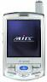



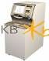
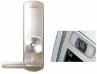


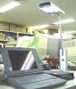
VLC application
Peripheral
Interface
(外围接口)
Bandwidth
Security
1nm
E-display
UV
380nm
Information
Broadcast
visible
Contents
Machine
e-book
Sign Board
SAMSUNG
ITS (Navigation)
780nm
IR
RF
Prohibited
100μm
Digital Hospital
Security
Banking
Door Lock
In Plane
3cm
RF
Visible
LAN
1m
LAN
Coverage
Mobility

Slide 21
Indoor application
LED Illumination Infrastructure
Ubiquitous
Fixed-to-Infra
Mobile-to-Infra
Mobile-to-Fixed
Mobile-to-Mobile
Security

Slide 22
Requirements (Indoor application)
 | Mobile to Mobile | Mobile to Fixed | Mobile to Infra | Fixed to Infra
Link | Bi-direction | Bi-direction | Bi or Uni | Bi or Uni
Reach | ~1m | ~1m | ~3m | ~3m
Rate | ~100M | ~100M | ~10M | ~10M
Application | Contents sharing | File transfer Video streaming M-commerce(移动商务) | Indoor navigation LBS(基于位置的服务) Networked robot (网络机器人) | Data broadcast
Alternative | IrDA, Bluetooth, UWB | IrDA, Bluetooth, UWB |  | WLAN

Slide 23
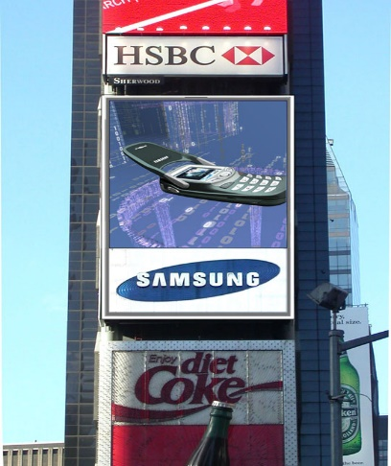
Outdoor application
Outdoor advertising
Traffic control Infrastructure
Vehicle-to-Infra
Vehicle-to-Vehicle

Slide 24

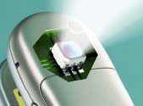
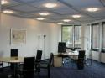

VLC application evolution
LED penetration
Mobile
Display
Sign
ITS
Illumination
10M
Outdoor
100M
Indoor
10M
Indoor

Slide 25

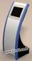
Indoor navigation scheme
 | Uni-direction | Bi-direction | Hybrid | Hot spot
Link
Rate | Down : ~10k | Down : ~10M Up : ~100M | Down : ~10k Up : ~10M | Down(light) : ~10k Down(HS) : ~100M
Infra | Lighting with optical ID | Lighting with optical ID Receiver In-building network Routing server | Lighting with optical ID RF access point In-building network Routing server | Lighting with optical ID Hot spot
Mobile | Receiver Large storage Map info Routing software | Receiver Transmitter | Receiver RF connectivity | Receiver Large storage Routing software
Other service |  | LBS Ad-hoc connection | LBS
Rx
TRx
Rx
Rx

Slide 26


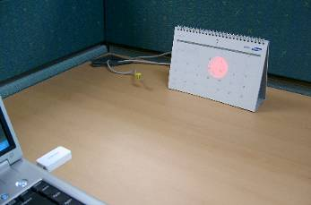
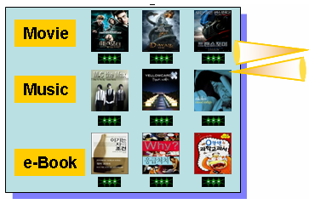
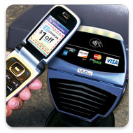
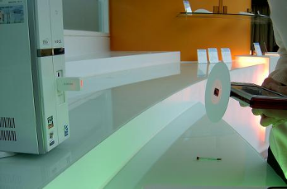
High-speed high-security connectivity
What You See Is What You Send
(WYSIWYS)
E-Contents Vending Machine
（电子内容物自动售货机）

Slide 27
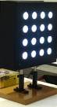
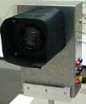
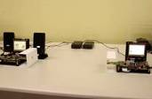
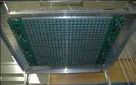
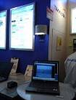
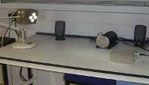
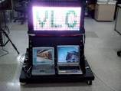
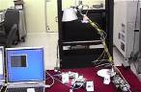
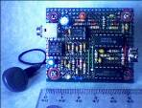


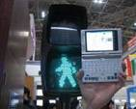
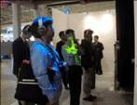
Demonstrations
Mobile to Mobile
(100Mbps,Samsung)
Tx, Rx
(~30Mbps,Oxford Univ.)
LED array
(~1Gbps, Keio Univ.（庆应义塾大学）)
High
speed
Music broadcasting
(6Mbps, Oxford Univ.)
Infra to Mobile
(10Mbps, Tamura Inc.)
Sign board
(10Mbps, Samsung)
Infra to Mobile(VLAN)
(4Mbps, Samsung)
Audio system
(100kbps, Hongkong Univ.)
Infra to Mobile, VLCC (Keio Univ., NEC, Toshiba, Sony, Matsushita, Casio etc. )
(4.8kbps, illuminations, visible light ID, sign board, applications based on JEITA)
Low
speed

Slide 28
Part 1
VLC introduction
LED introduction
VLC potential application
Part 2
VLC components
Technical challenges

Slide 29
Overview
Visible Light Communications
Transmitter
Channel
Receiver
Technical challenges
Higher bandwidth
Enabling mobility and reliability

Slide 30
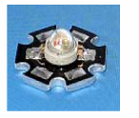
VLC Sources
Blue LED & Phosphor(磷光体)
Low cost
Phosphor limits bandwidth
Modulation can cause colour shift
RGB triplet
Higher cost
Potentially higher bandwidth
Potential for WDM (波分复用)
Modulation without colour shift
Single chip LED spectrum
RGB LED spectrum

Slide 31
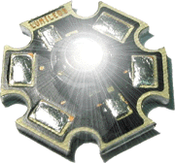
LED Modulation
Opto-electronic response
SPICE Model
R_{s} = 0.9727 Ω
L = 33.342 nH
C_{s} = 2.8 nF
C_{d} = 2.567 nF
tt = 1.09 ns
Luxeon LED
Measured LED small-signal bandwidth
Page 5

Slide 32
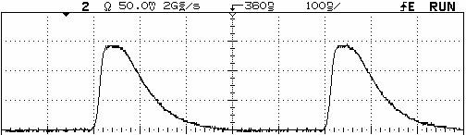
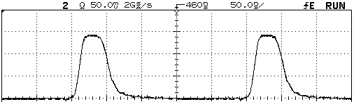
Improvement of LED response
Using blue-response only (blue filtering)
~130 ns
Blue filtering
~25 ns
Measured optical spectrum
Measured impulse response
Issue: Only 10% of signal power is recovered
⇒ Reducing SNR, link distance
LEDs with more blue energy [1] could be used to gain more filtered power, however the balance of white colour is shifted
[1] Grubor, J., et al., "Wireless high-speed data transmission with phosphorescent white-light LEDs", Proc. ECOC 07 (PDS 3.6), pp. 1-2. ECO [06.11], 16-20 Sep. 2007, Berlin, Germany
Page 10

Slide 33
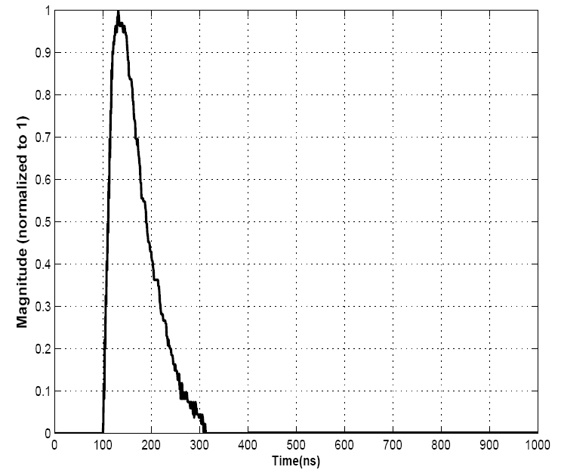
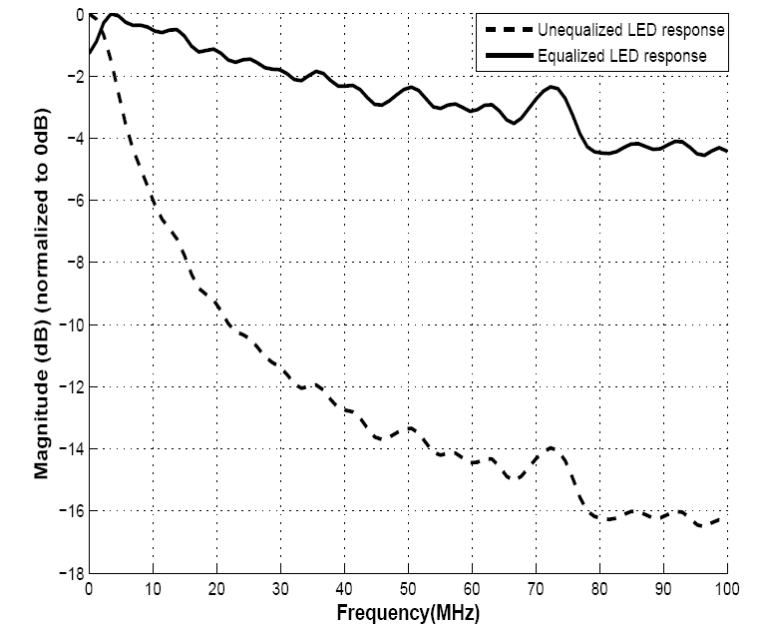
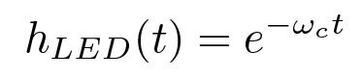
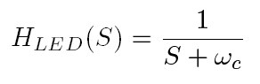
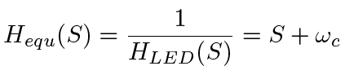
Improvement of channel response
Receiver equalisation
Fitting falling time curve
Equalization
Measured LED impulse response
Improved LED transmission BW
Page 11

Slide 34
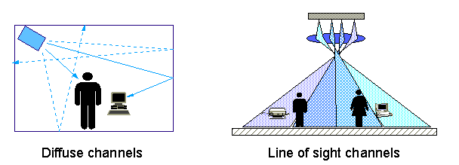
Channel modelling
Two propagation paths:
Line of sight (LOS): strong paths calculated using the illumination patterns from LED arrays
Diffuse (漫射): modelled by assuming the room is equivalent to an integrating sphere
Channel impulse response is calculated for each point in the room
Page 6

Slide 35
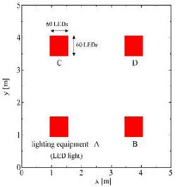


VLC modelling

Slide 36

Room Power Distribution
Assume
1% modulation of typical illumination power
Typical receiver performance
Conclusions
Very high SNR available
SNRmin = 38.50dB
SNRmax = 49.41dB
Modulation limited by source bandwidth

Slide 37
Noise sources
Optical noise
Daylight
Generates DC photocurrent (光电流)
Blocked at receiver due to AC coupling
Creates shot noise
Other optical sources
Fluorescent, Incandescent (荧光,白炽)
Creates electrical interference photocurrent harmonics
Mitigated by
Optical filtering
Wavelength is in band of desired signal
Electrical filtering

Slide 38
Optical receiver
Receiver consists of
Optical filter
Rejects ‘out-of-band’ ambient illumination noise
Lens system or concentrator (透镜系统或聚光镜)
Collects and focuses radiation
Photodetector (光电探测器,or array of detectors)
Converts optical power to photocurrent
Incoherent detection
Preamplifier (前置放大器, or number of preamplifiers)
Determines system noise performance
Post-amplifier and subsequent processing

Slide 39
Optical receiver: constant radiance theorem (常辐射定理)
Optical ‘gain’ of receiver limited by required field of view (FOV,可见区)
Ω_{i}
A_{i}
A_{i}Ω_{i}<=A_{o}Ω_{ο}
A_{i}Ω_{i}<=A_{o}2π
Ω_{ο}
A_{o}

Slide 40
Receiver performance: figure of merit (品质因数)
Receiver Figure of Merit (FOM)
Fibre systems
Performance determined by sensitivity (given sufficient detector area)
FOV usually not relevant
Free space systems
Etendue crucial determinant
Field of view 2π Sr
Detector
Bit rate R_{b}
Area
A
Receiver
sensitivity
Pmin

Slide 41


Typical link: components
Transmitter and receiver specifications
Transmitter
16 Luxeon LEDs
P_{ILLUM} = 1.5W
LED pitch = 60 mm
I_{DC} = 220 mA
Mod-index = 0.1
45º wide-beam lens
7 resonant freq.
Flat BW of 25 MHz
2×R_{illum} = 3 m
L_{LOS} = 2 m
Receiver
Concentration lens
D = 50mm
F = 60mm
Detection area
35 mm²
Pre-Amp
Post-Amp
(ampl. limiting)
Range
L = 2 m
R_{illum} = 1.5 m
R_{comm} = 0.5 m
Page 22

Slide 42
Typical link: illumination
Power distribution in receiving plane

Slide 43



Typical link: BER performance
Eye diagram
30 Mb/s
40 Mb/s
NRZ
50 Mb/s
System test in normal lighting condition (room filled with other high-power white light sources)
Longer distance ⇒ SNR penalty (BER)
Flat BW ⇒ baseline wandering reduction
Page 23

Slide 44

Bandwidth improvement: post equalisation
Pre- and post-equalization: single LED link
Pre-equalisation: experiment
Post-equalisation: simulation

Slide 45
Retro-reflecting link (回复反射链路)
Novel optical communications between reader and tag
Low power (tag has no source)
Long range (determined by illumination source )
Visibly secure (user can see beam of light)
Notes:
44

Slide 46
Retro-reflecting link demonstration system
Demonstrator
2.4kb/s bi-directional communication over several metres
Notes:
45

Slide 47
Future developments: optical MIMO
RF MIMO
Scattering provides invertible H matrix and decorrelation (capacity gain)
Difficult to shape radiation pattern with small antenna
Optical MIMO
No decorrelation
Invertible H matrix achieved by system and geometry design
Simple low-cost elements (lenses) can provide high directivity and/or complex beamshaping

Slide 48
MIMO VLC: simulation system

Slide 49


MIMO VLC: preliminary Results
Position of the receiver
Aggregate data rate is linearly proportional to the number of channels and channel rate
Page 31

Slide 50
Future technical challenges
Data rate
Equalisation
MIMO
Complex modulation
Integration in infrastructure
Uplink
Retro-reflecting link
RF/VLC integration

Slide 51
Homework
1. Give some application examples of VLC.
2. What are the General Characteristic of VLC?
Tips: Q1, P19; Q2, P3
5月31号交

